Slide 1
Mind and Machine Intelligence
Neil D. Lawrence

Slide 2


Slide 3
E S A R I N T U L
O M D P C F B V
H G J Q Z Y X K W

Slide 4

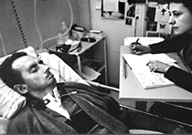

bits/minute
6
2000
billions
a billion
billion
a billion
billion
calculations/s
trillions
5 trillion
years
15 billion
years
20
minutes
embodiment
Notes:
Image sources: https://en.wikipedia.org/wiki/Jean-Dominique_Bauby#/media/File:Jean-Dominique_Bauby.jpg, self, http://res.publicdomainfiles.com/pdf_view/108/13955796621856.png

Slide 5
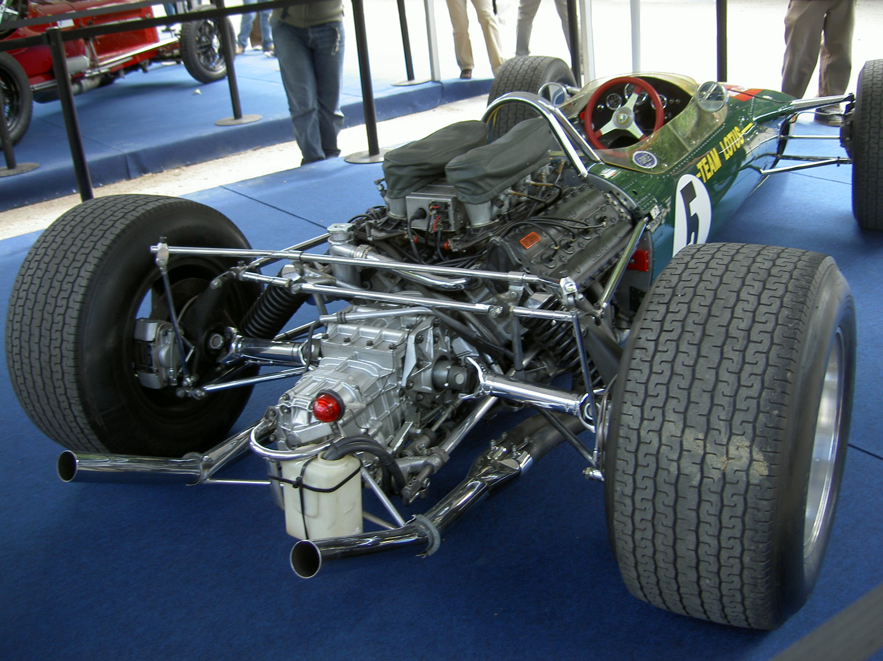
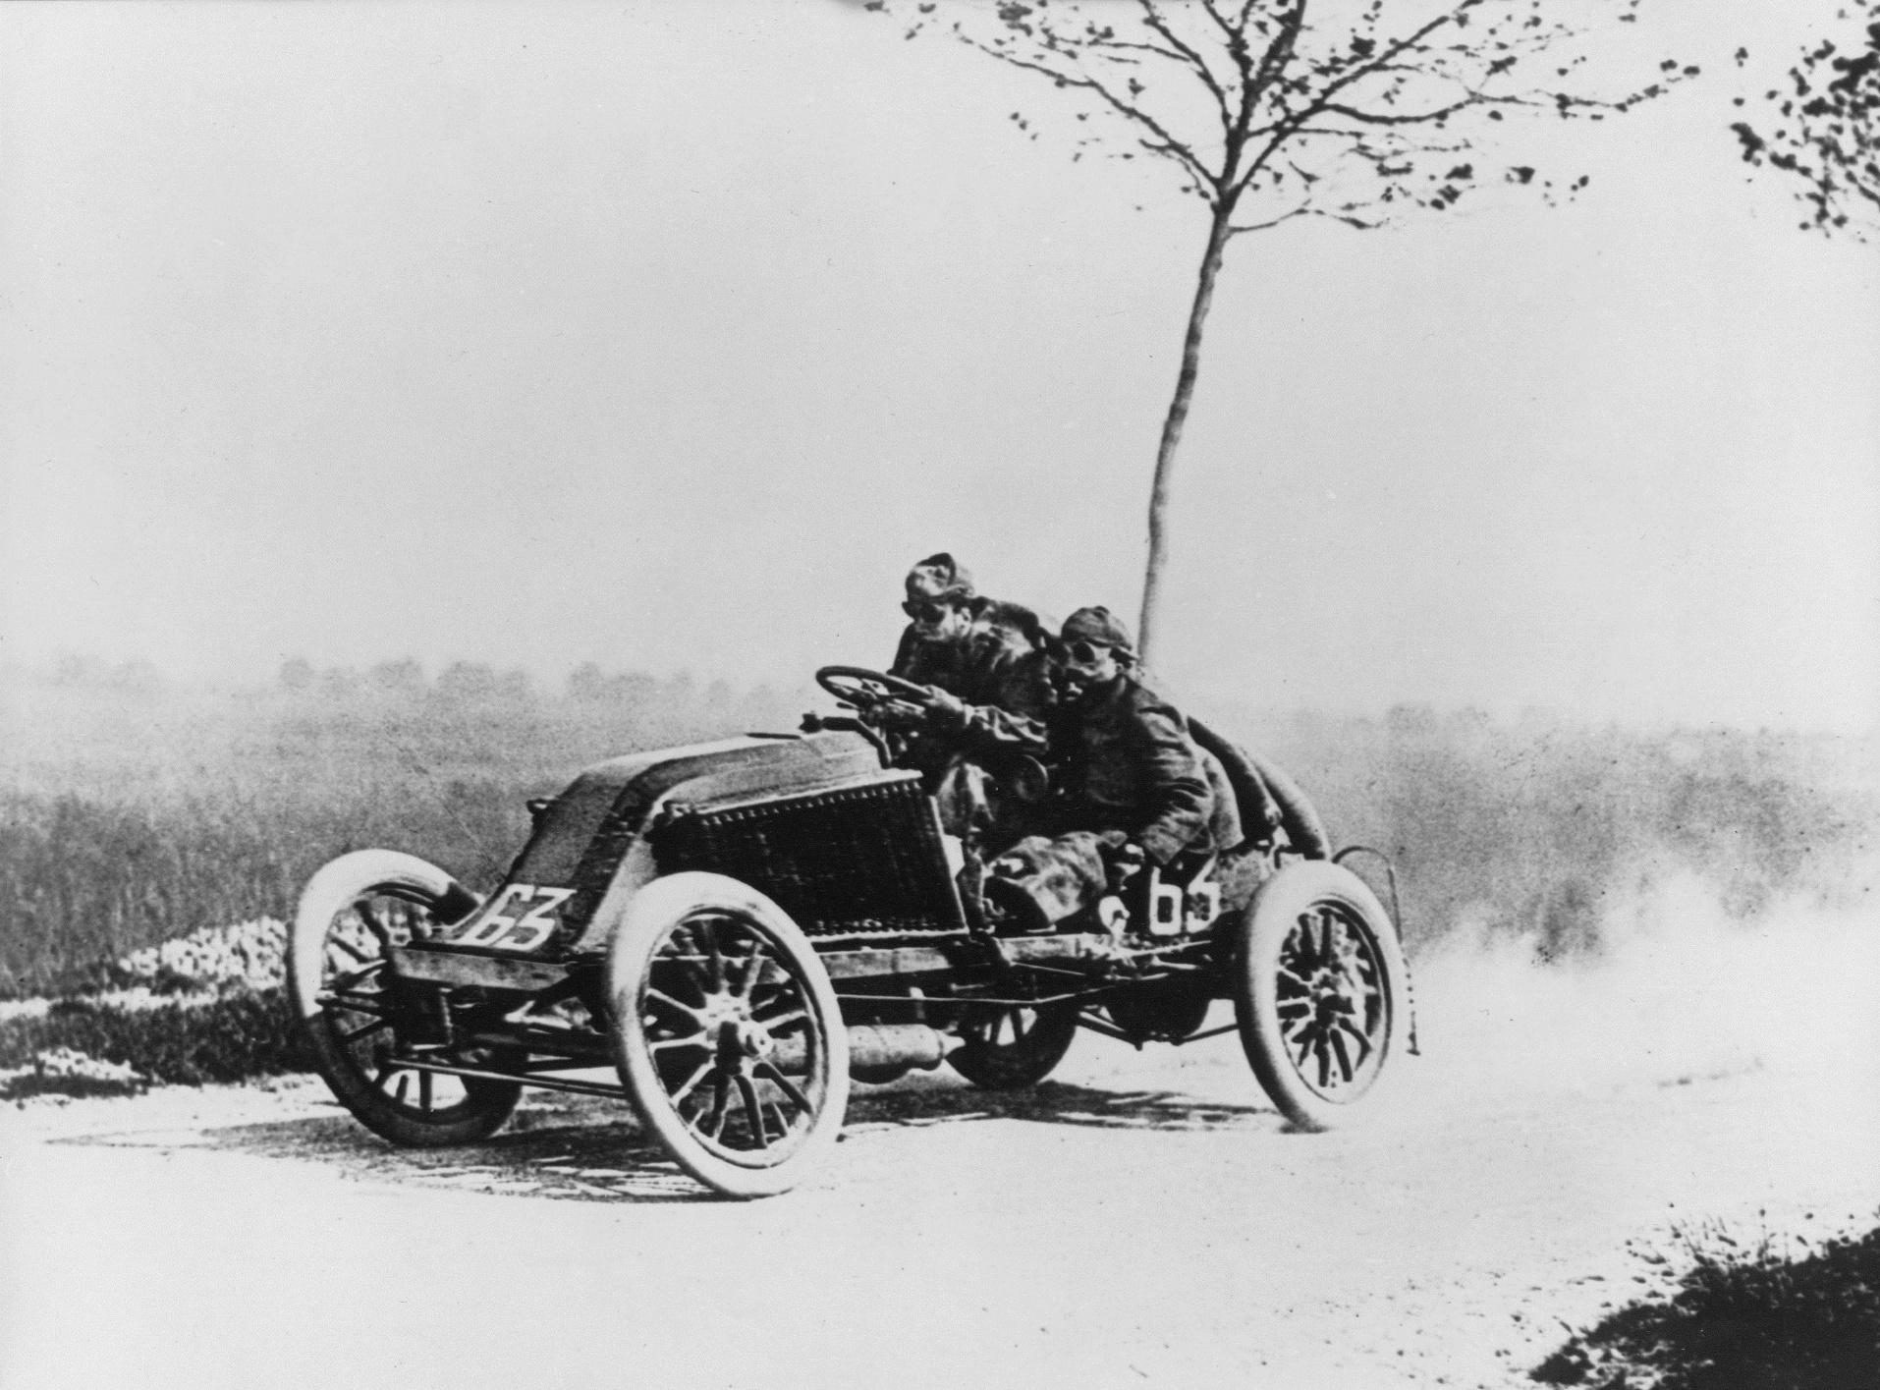
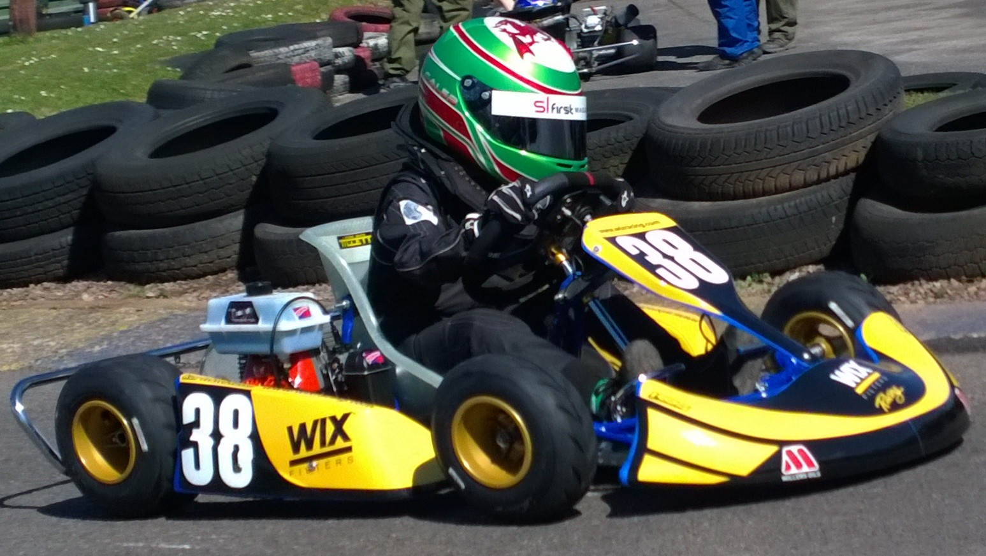
Notes:
Image sources: https://upload.wikimedia.org/wikipedia/commons/1/17/Lotus_49-2.JPG
https://upload.wikimedia.org/wikipedia/commons/f/fe/Marcel_Renault_1903.jpg
https://upload.wikimedia.org/wikipedia/en/b/b9/Caleb_McDuff_WIX_Silence_Racing_livery.jpg

Slide 6
?
!#@%&?
#
!
&
!
£*?$&!
&
?
#
Notes:
Image source: https://www.flaticon.com/free-icon/brain-inside-human-head_30609

Slide 7
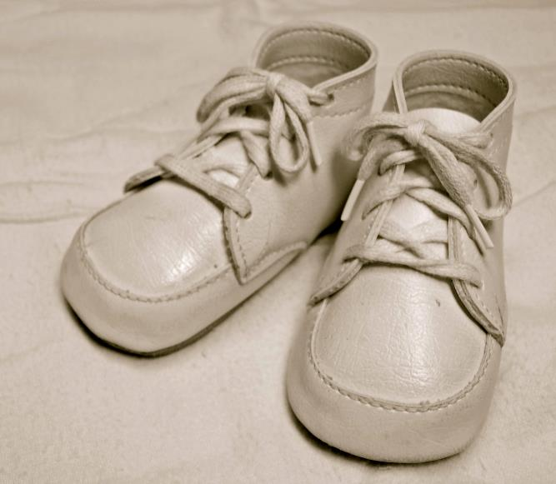
For Sale, Baby Shoes, Never Worn
Notes:
Slide image source: https://upload.wikimedia.org/wikipedia/commons/5/54/Classic_baby_shoes.jpg

Slide 8


No
!#@%&?
!
No
Notes:
Image source: https://www.flaticon.com/free-icon/brain-inside-human-head_30609, http://res.publicdomainfiles.com/pdf_view/108/13955796621856.png

Slide 9
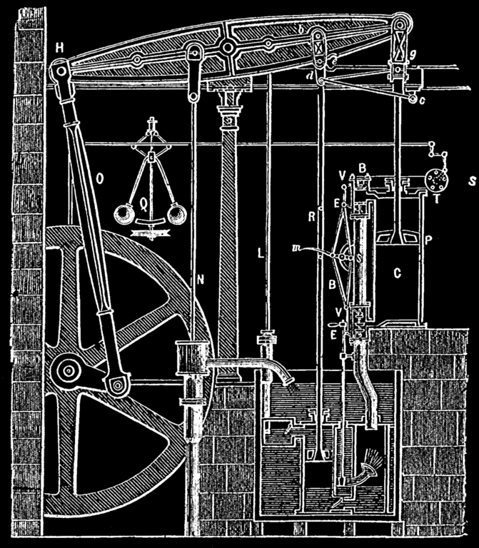
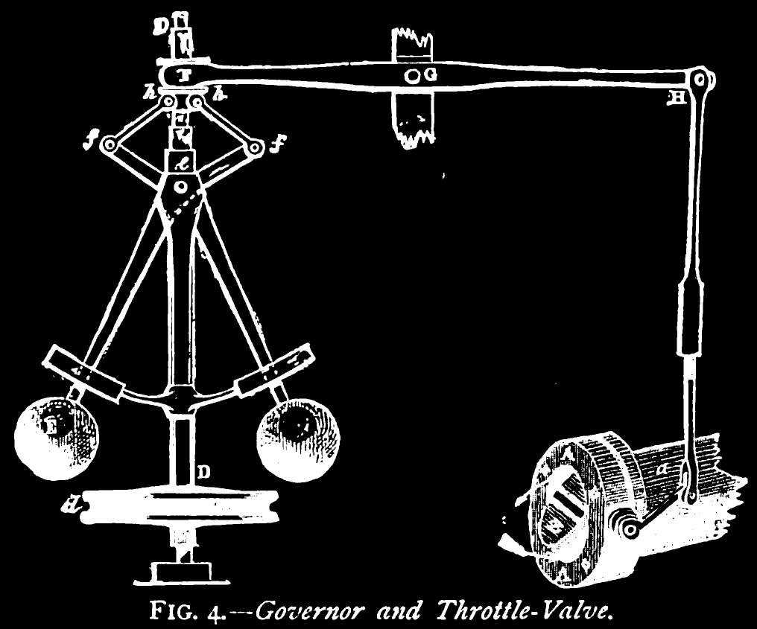
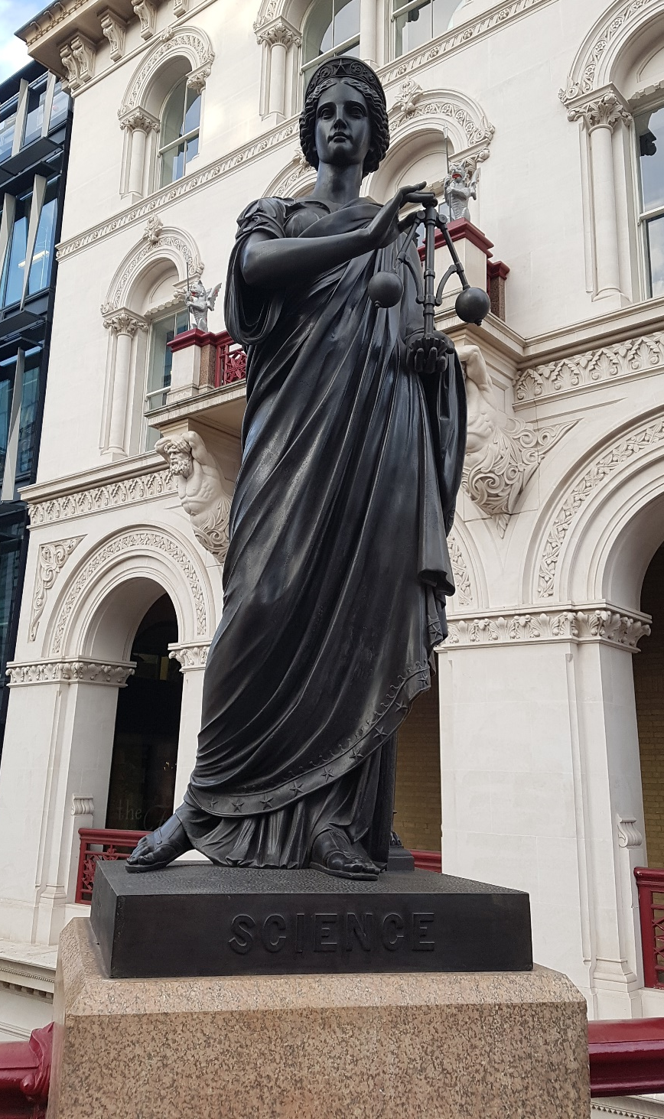
Notes:
Image credits: Neil took the photo
https://upload.wikimedia.org/wikipedia/commons/thumb/f/f2/SteamEngine_Boulton%26Watt_1784.png/671px-SteamEngine_Boulton%26Watt_1784.png

Slide 11
compute
data
+ model
prediction

Slide 12
Outline of the DeepFace architecture. A front-end of a single convolution-pooling-convolution filtering on the rectified input, followed by three locally-connected layers and two fully-connected layers. Color illustrates feature maps produced at each layer. The net includes more than 120 million parameters, where more than 95% come from the local and fully connected layers.
Source: DeepFace
Notes:
Modern Inference Engine
120 million parameters, 1 billion images, near human performance

Slide 13
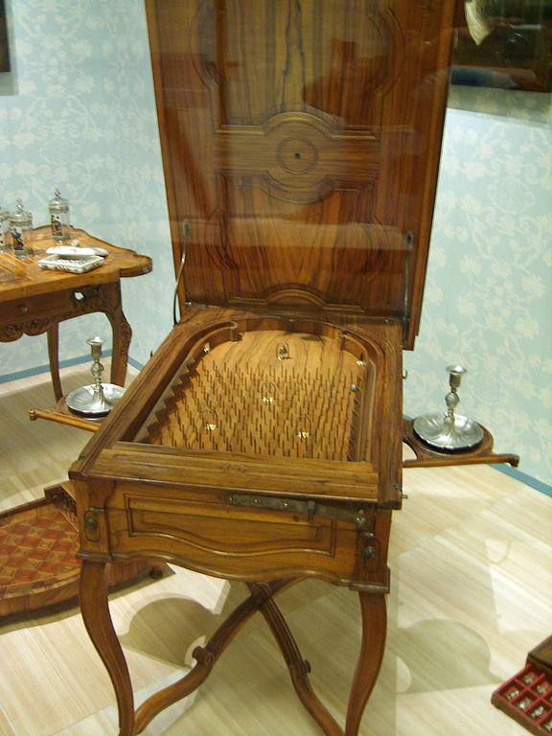
Notes:
Internal structure of the machine like layers of pins
Initial state of machine.
Moving pins around to fix

Slide 14
Yes
No

Slide 15
Yes
No

Slide 16
System Design
decomposition
data
deployment

Slide 17
Thanks!
twitter: lawrennd
blog: https://inverseprobability.com
podcast: The Talking Machines

